Slide 1



EVERGAIN LIMITED · KICD GRADE 9 · COMPETENCY BASED CURRICULUM
Learner Guide
How to use the Grade 9 Interactive Digital Content — online at cbc.evergain.co.ke, or fully offline from a flash disk.
RFB KE-ICTA-543406-GO-RFB · Competency Based Curriculum · Grade 9
Evergain Limited · Grade 9 Interactive Digital Content · Learner Guide
Notes:
Welcome. This guide shows learners (and teachers supporting them) how to open the content, move through a subject, and use every kind of activity. Nothing in learner mode can change the content — it is read-only by design.

Slide 2
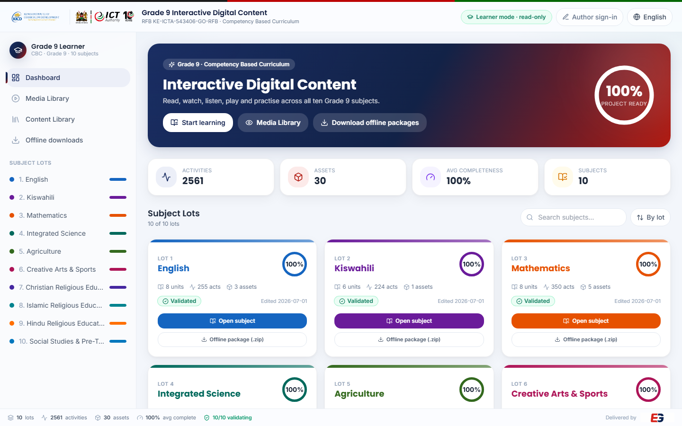
What you get
Ten learning areas of Grade 9 CBC content, built to be read, watched, listened to, played and practised.
10
2,561
learning areas (subjects)
interactive activities
115
16
video lessons with subtitles
virtual science labs
Evergain Limited · Grade 9 Interactive Digital Content · Learner Guide
Notes:
Every subject has units, lessons and activities: readings, videos, audio, quizzes, matching, games, animations, virtual labs and image studies. Everything also works with no internet.

Slide 3


Two ways to use it
Same content, same look — choose whichever suits your school.
Online — in a web browser
Offline — from a flash disk
Go to cbc.evergain.co.ke — it opens in Learner mode (read-only).
Works in Chrome, Edge, Firefox or Safari on a laptop, tablet or phone.
Videos stream, so you need an internet connection.
Use the Media Library to jump straight to any video, audio, game or lab.
Each subject is its own package (one folder, one index.html).
No internet, no installation, no server — just open index.html.
Videos, subtitles, labs, games and images are all inside the folder.
Audio lessons and the Listen button narrate on the device itself.
Evergain Limited · Grade 9 Interactive Digital Content · Learner Guide
Notes:
Point out that the offline package is complete: the only online-only feature is the AI helper, which is hidden offline.

Slide 4
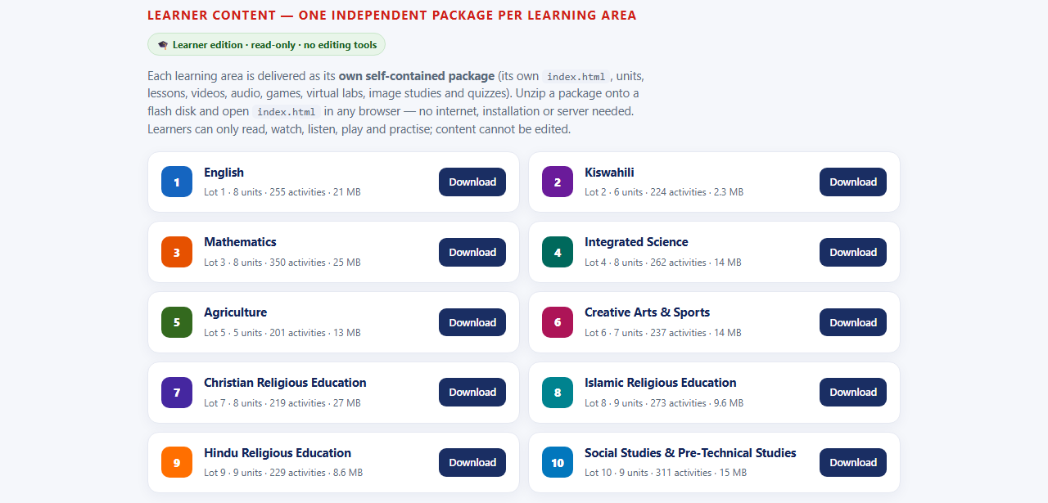
Get your subject on a flash disk
Four steps — about two minutes per subject.
1
Open the download page
Visit cbc.evergain.co.ke/download/ (or click Offline downloads in the app).
2
Download your subject
Click Download next to the learning area you need. Each subject is a separate .zip file (2–27 MB).
3
Unzip onto the flash disk
Right-click the .zip → Extract All. Keep the whole folder together — do not move files out of it.
4
Open index.html
Double-click index.html inside the folder. It opens in your browser and works with no internet.
Evergain Limited · Grade 9 Interactive Digital Content · Learner Guide
Notes:
The zip extracts to a folder named after the subject, e.g. Evergain_Grade9_LOT-03_Mathematics. Copy that whole folder to the flash disk.

Slide 5
Direct links for each subject
Short links you can type, share by WhatsApp or print. Each one downloads that subject's offline package.
Lot | Learning area | Direct download link
1 | English | cbc.evergain.co.ke/download/english
2 | Kiswahili | cbc.evergain.co.ke/download/kiswahili
3 | Mathematics | cbc.evergain.co.ke/download/mathematics
4 | Integrated Science | cbc.evergain.co.ke/download/integrated-science
5 | Agriculture | cbc.evergain.co.ke/download/agriculture
6 | Creative Arts & Sports | cbc.evergain.co.ke/download/creative-arts-sports
7 | Christian Religious Education | cbc.evergain.co.ke/download/christian-re
8 | Islamic Religious Education | cbc.evergain.co.ke/download/islamic-re
9 | Hindu Religious Education | cbc.evergain.co.ke/download/hindu-re
10 | Social Studies & Pre-Technical Studies | cbc.evergain.co.ke/download/social-studies-pts
All | All ten subjects in one app (demo copy, 156 MB) | cbc.evergain.co.ke/download/all
Evergain Limited · Grade 9 Interactive Digital Content · Learner Guide
Notes:
Links redirect to the actual .zip file. The lot-number form also works, e.g. /download/lot-03.

Slide 6
The home page
What you see when the content opens (online). Learner mode is on by default — nothing here can be edited.
1
6
1
Learner mode · read-only badge — confirms you are in the safe learner view.
2
Start learning opens the first subject; Media Library lists every video, audio, lab and game.
2
3
3
Download offline packages takes you to the per-subject flash-disk downloads.
4
Open subject — enter a learning area. Every subject card shows its units and activity count.
5
Offline package (.zip) — download just this subject for a flash disk.
6
English ⇄ Kiswahili switches the interface language.
4
5
Evergain Limited · Grade 9 Interactive Digital Content · Learner Guide
Notes:
Author sign-in (top right) is for curriculum developers only; learners never need it.

Slide 7
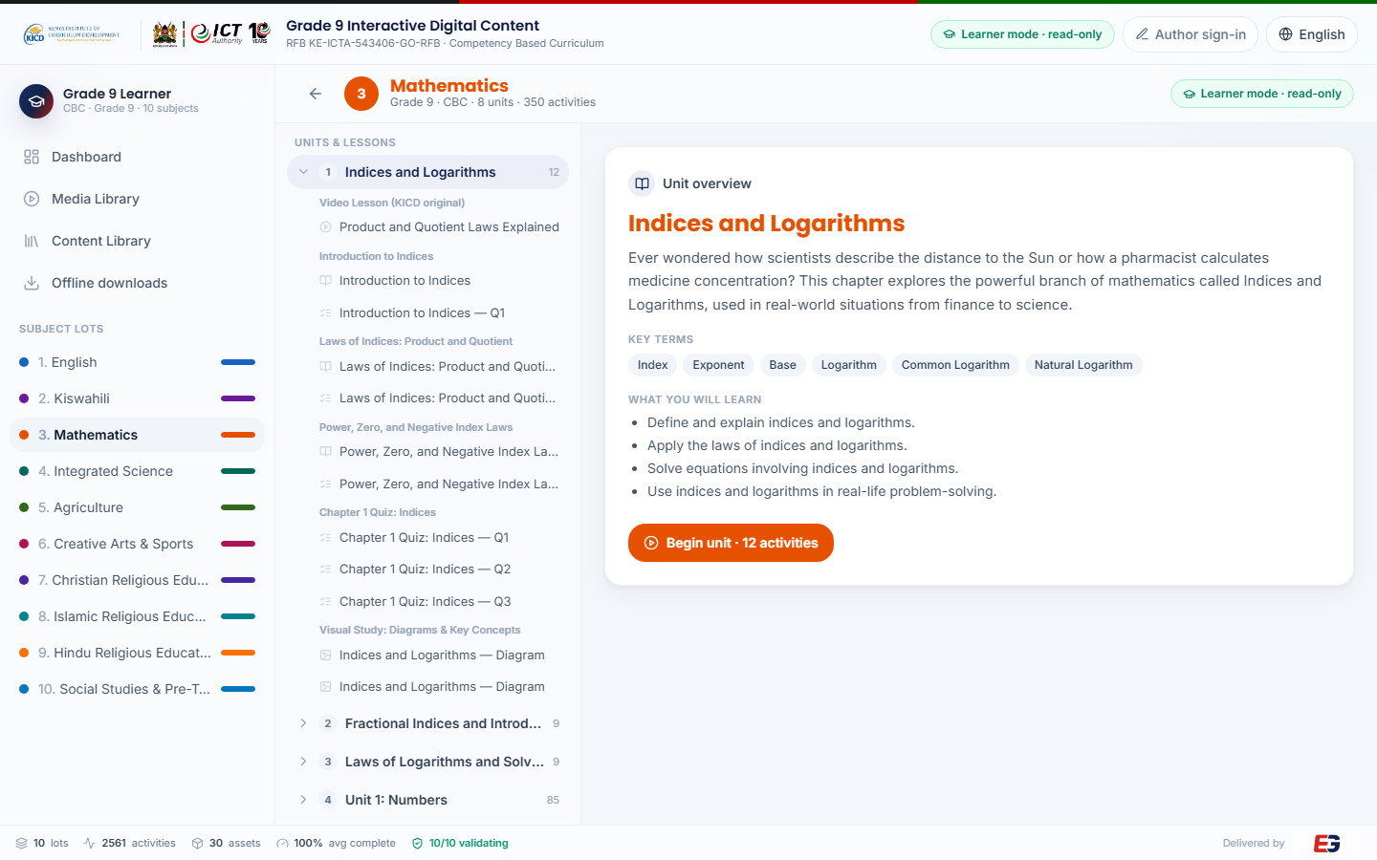
Choose a unit, then begin
Inside a subject: pick a unit on the left, read the overview, then press Begin unit.
1
Units & lessons — click a unit to expand its lessons; click any activity to open it.
5
1
2
Unit overview — a short hook explaining what the unit is about.
2
3
Key terms you will meet, and what you will learn (the unit outcomes).
3
4
Begin unit starts at the first activity; Prev / Next then walk you through the rest.
5
The read-only badge stays visible — there is no editing in learner mode.
4
Evergain Limited · Grade 9 Interactive Digital Content · Learner Guide
Notes:
Activities inside a lesson are ordered: reading → video → audio → questions → key terms → game/animation/lab.

Slide 8
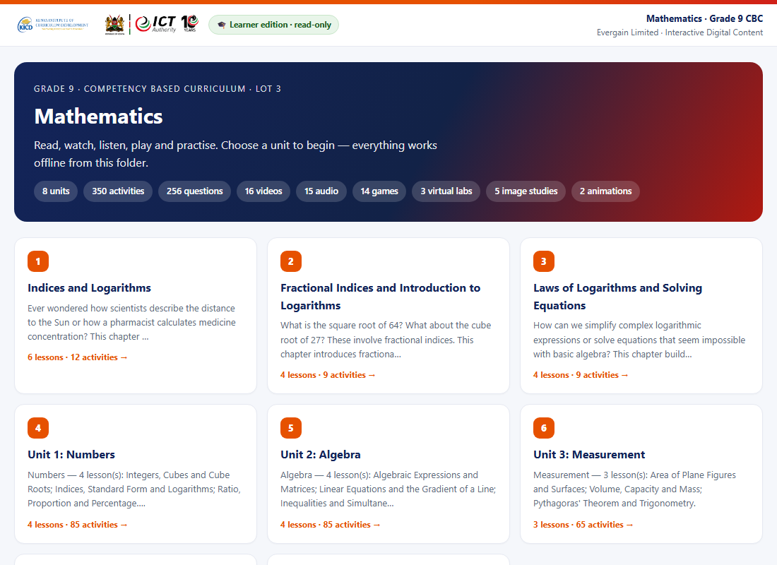
Inside an offline subject package
The flash-disk edition has the same content, arranged as simple pages that work from the folder.
1
Subject launcher (index.html) — the counts show what is inside this package.
1
2
Unit cards — click a unit to see its lessons and activities.
3
Each unit page lists lessons with a badge per activity type and an estimated time.
4
Every activity page has ← Unit, Prev and Next at the top, so you never get lost.
2
3
Evergain Limited · Grade 9 Interactive Digital Content · Learner Guide
Notes:
Works in any browser straight from the flash disk. No files need to be installed.

Slide 9









Nine kinds of activities
Every subject mixes all of these. The badge on each lesson tells you which it is.
Reading
Video lesson
Audio lesson
A clear explanation with Kenyan examples. Press Listen to hear it read aloud.
Short lesson videos with subtitles on by default, key points and a transcript.
Listen-along narration of the lesson. Works offline — no audio file needed.
Quiz question
Matching pairs
Learning game
Multiple choice with instant feedback, an explanation and a hint.
Match key terms to their meanings. Check your answers when you are done.
Sort, put-in-order and memory-match games — scored automatically.
Animation
Virtual lab
Image study
A process shown step by step (e.g. the water cycle), with narration.
Hands-on science simulations (PhET). Change the controls and see what happens.
A diagram or table to study, with the key ideas explained underneath.
Evergain Limited · Grade 9 Interactive Digital Content · Learner Guide
Notes:
All six media types required by the tender — text, video, audio, animation, games and images — appear as real activities in every subject.

Slide 10
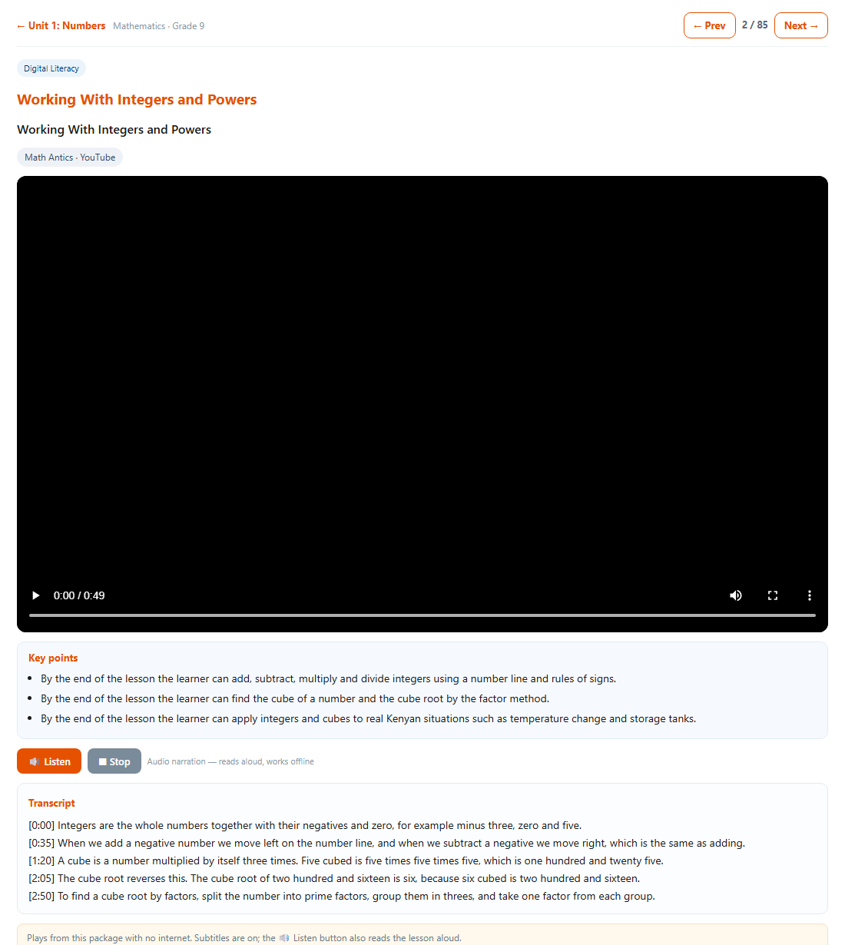
Video lessons
Play, read along, or listen — all from the package, no internet needed.
1
1
← Unit takes you back; Prev / Next move between activities (e.g. 2 / 85).
2
2
Press play. Subtitles are switched on by default — use the CC button to toggle them.
3
Key points summarise the lesson in a few bullets.
4
Listen reads the transcript aloud using the device's own voice — handy without headphones.
5
The full transcript is below the video; Mark as watched records your progress.
3
4
5
Evergain Limited · Grade 9 Interactive Digital Content · Learner Guide
Notes:
Online, the same lesson streams from YouTube with captions on; offline it plays the bundled MP4 with subtitles.

Slide 11
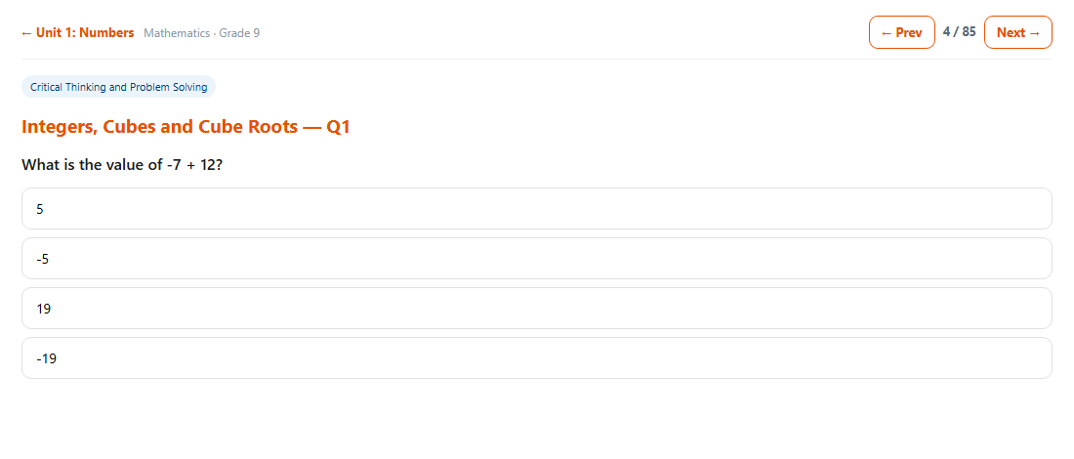
Quizzes with instant feedback
Tap an answer: correct turns green with an explanation; a wrong choice turns red and lets you try again.
3
1
The question — one correct answer out of four.
2
Tap an option. You get feedback immediately, with a short explanation of why.
1
2
3
Prev / Next continue the lesson; questions are part of the same flow as videos and readings.
4
There are over 1,800 questions across the ten subjects — roughly fifteen per lesson.
Evergain Limited · Grade 9 Interactive Digital Content · Learner Guide
Notes:
Fill-in-the-blank and matching activities work the same way: answer, then Check.

Slide 12

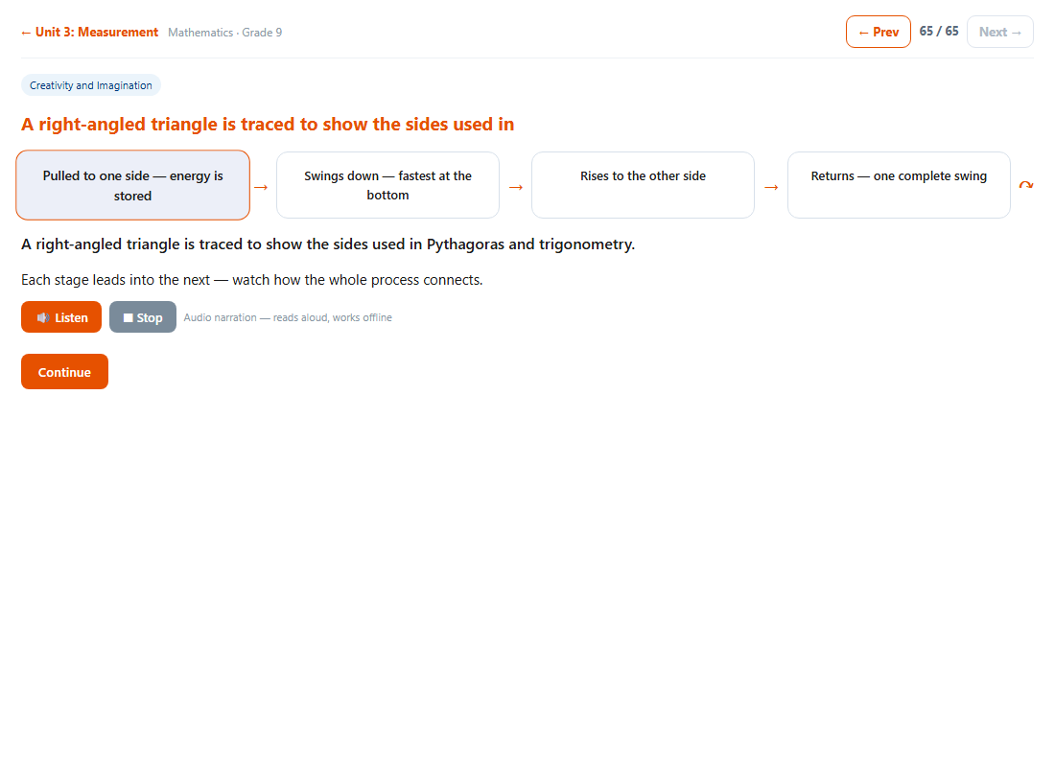
Games and animations
Playable, auto-scored games and step-by-step animated diagrams — built in, no downloads.
Learning game — drag items into groups, put steps in order, or find matching pairs. Your score appears when you finish.
Animation — the active stage highlights as the cycle plays. Press Listen to hear the explanation.
Evergain Limited · Grade 9 Interactive Digital Content · Learner Guide
Notes:
Games and animations are pure HTML — they run on any device, including low-cost laptops and tablets.

Slide 13
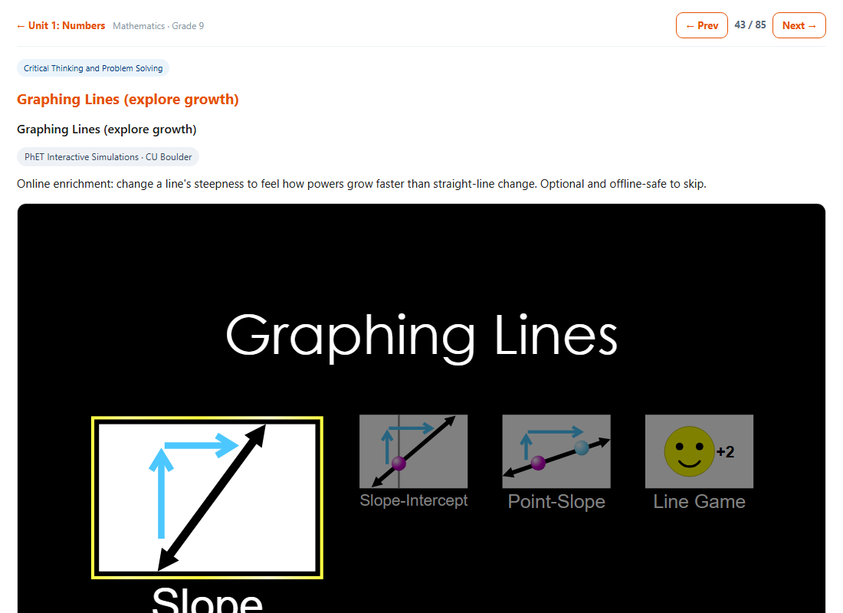
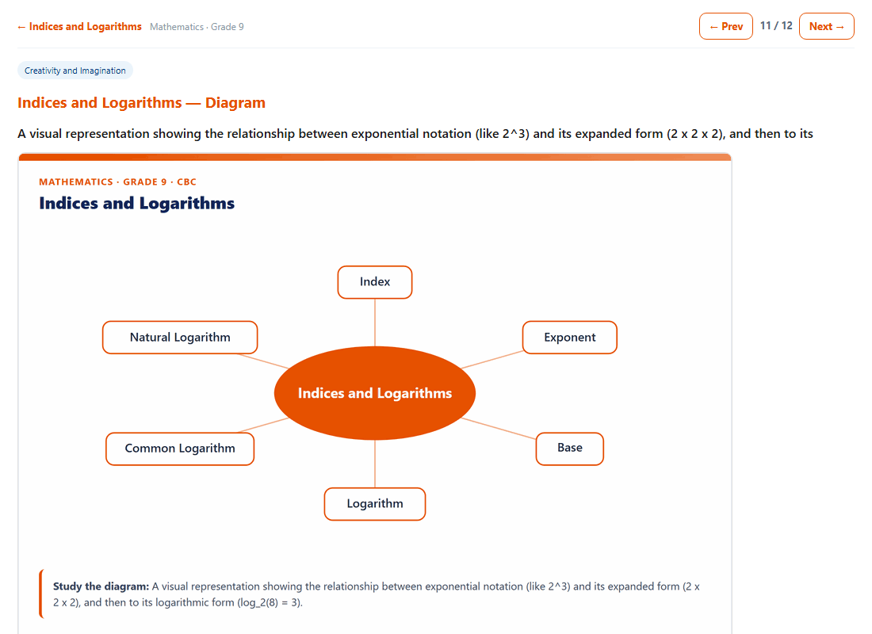
Virtual labs and image studies
Experiment safely, and study diagrams and tables with the key ideas explained.
Virtual lab (PhET) — change the controls and watch the result. Follow the "Try this" steps under the simulation.
Image study — a diagram or data table to study, with a "Study the diagram" note and the explanation beneath.
Evergain Limited · Grade 9 Interactive Digital Content · Learner Guide
Notes:
Labs are bundled inside the package so they run offline too.

Slide 14
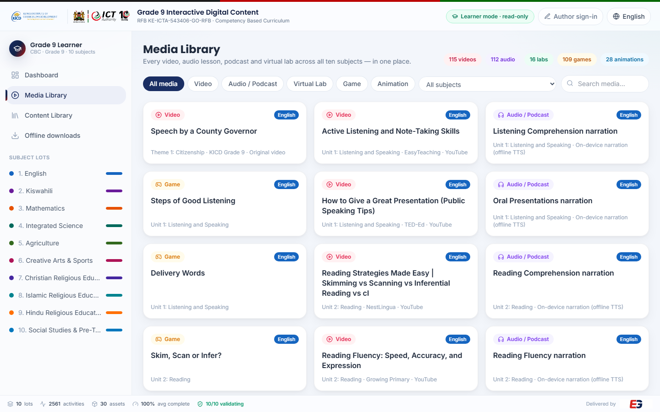
Find any video, audio, lab or game fast
The Media Library (online) gathers every media activity across all ten subjects.
1
Counts of videos, audio, labs, games and animations available.
1
2
3
Filter by media type, or choose a single subject.
2
4
Search by title.
3
4
Click any card to play it in a pop-up; close it to keep browsing.
5
Content Library (sidebar) lists every activity as text, for quick reading.
Evergain Limited · Grade 9 Interactive Digital Content · Learner Guide
Notes:
In the offline package, use the unit pages instead — every lesson lists its media with a badge.

Slide 15



Tips and troubleshooting
Most questions have a one-line answer.
Language & audio
Using a flash disk
Read-only by design
English ⇄ Kiswahili: use the language button at the top right.
Listen uses the device's built-in voice — it works offline and needs no download.
Subtitles are on by default; use the video's CC button to switch them off.
No sound? Check the device volume and that the browser is not muted.
Keep the whole subject folder together — moving files breaks the links.
Open index.html with Chrome, Edge or Firefox for the best experience.
A video that will not play in one browser usually plays in Chrome.
Copy the folder onto the computer for faster loading of large labs.
Learner mode cannot change, add or delete lessons — this is intentional.
If a lesson looks wrong, tell your teacher or the content administrator.
Author sign-in is for curriculum developers and needs a passcode.
Your progress marks (Mark as watched / complete) stay on this device.
Evergain Limited · Grade 9 Interactive Digital Content · Learner Guide
Notes:
Escalation path: learner → teacher → Evergain support (contact on the last slide).

Slide 16
Need help?
Online platform: cbc.evergain.co.ke
Offline packages (all subjects): cbc.evergain.co.ke/download/
Evergain Limited · info@evergainlimited.com · +254 747 258 516 · www.evergainlimited.com
Grade 9 Interactive Digital Content for the Competency Based Curriculum — delivered for ICTA / KICD (RFB KE-ICTA-543406-GO-RFB).
Evergain Limited · Grade 9 Interactive Digital Content · Learner Guide
Notes:
Thank you.

