Slide 1



EVERGAIN LIMITED · KICD GRADE 9 · COMPETENCY BASED CURRICULUM
Administrator & Author Guide
Edit rights: unlocking Author mode, authoring and reviewing content, packaging, publishing the offline learner packages, and keeping learners in read-only mode.
RFB KE-ICTA-543406-GO-RFB · Competency Based Curriculum · Grade 9
Evergain Limited · Grade 9 Interactive Digital Content · Administrator & Author Guide
Notes:
This guide is for curriculum developers and platform administrators. Learners never need it — the platform opens in read-only Learner mode for everyone by default.

Slide 2


Two modes, two roles
Everyone starts as a learner. Editing needs Author mode, which is unlocked with a passcode.
Learner mode (default, read-only)
Author mode (edit rights)
Browse subjects, units and lessons; play every activity.
Media Library, Content Library and offline downloads.
No add / edit / delete, no Save, no packaging, no settings.
The flash-disk editions have authoring compiled out entirely — it cannot be unlocked there.
Create and edit units, lessons and all 11 activity types.
AI Authoring Assistant drafts activities from a topic.
Package Manager: validate → package → AES-encrypt each lot.
Settings: export / import the project as JSON, reload official content.
Evergain Limited · Grade 9 Interactive Digital Content · Administrator & Author Guide
Notes:
Author mode is remembered per browser until you click Exit author mode.

Slide 3
Unlock Author mode
Top-right of the header — one click and a passcode. Exit author mode returns the browser to the learner view.
Before: learner view
1
2
After: Author mode
3
4
1
Learner mode badge
2
Author sign-in
Shown to everyone. Confirms the read-only view is active.
Click it and enter the passcode: EVERGAIN-AUTHOR-2026
3
Author mode badge
4
Exit author mode
Editing tools, Package Manager, Settings and the AI assistant appear.
Locks the browser back to learner view. Always do this on shared computers.
Evergain Limited · Grade 9 Interactive Digital Content · Administrator & Author Guide
Notes:
The passcode is a mode gate that keeps learners in the read-only experience; it is not a security boundary. Change it in src/authoring/stores/uiStore.ts (AUTHOR_CODE) and rebuild.

Slide 4
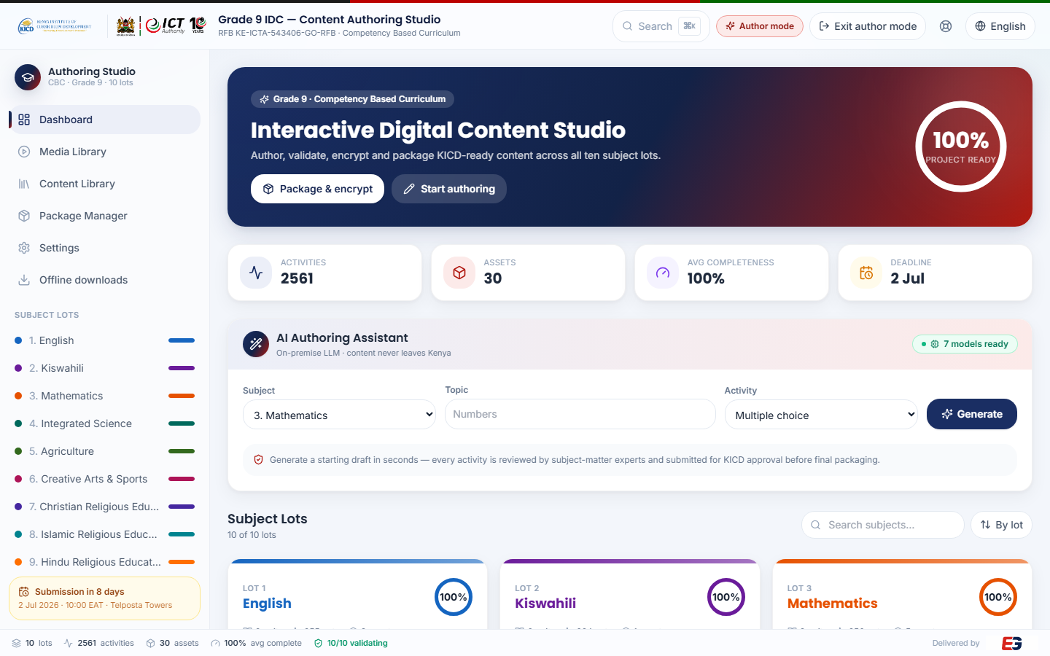
The author dashboard
Everything you need to author, validate and package the ten subject lots.
1
1
Author mode badge and Exit author mode.
2
Package & encrypt (Package Manager) and Start authoring (opens Lot 1).
2
5
3
Live totals: activities, assets, completeness, deadline.
3
4
AI Authoring Assistant — on-premise model; "7 models ready" means drafting is available.
4
5
Package Manager and Settings appear in the sidebar only in Author mode.
6
Subject cards gain Edit, Preview and Package buttons.
6
Evergain Limited · Grade 9 Interactive Digital Content · Administrator & Author Guide
Notes:
The Search box (Ctrl/Cmd+K) opens the command palette: jump to any subject, export/import, or reload the official content.

Slide 5
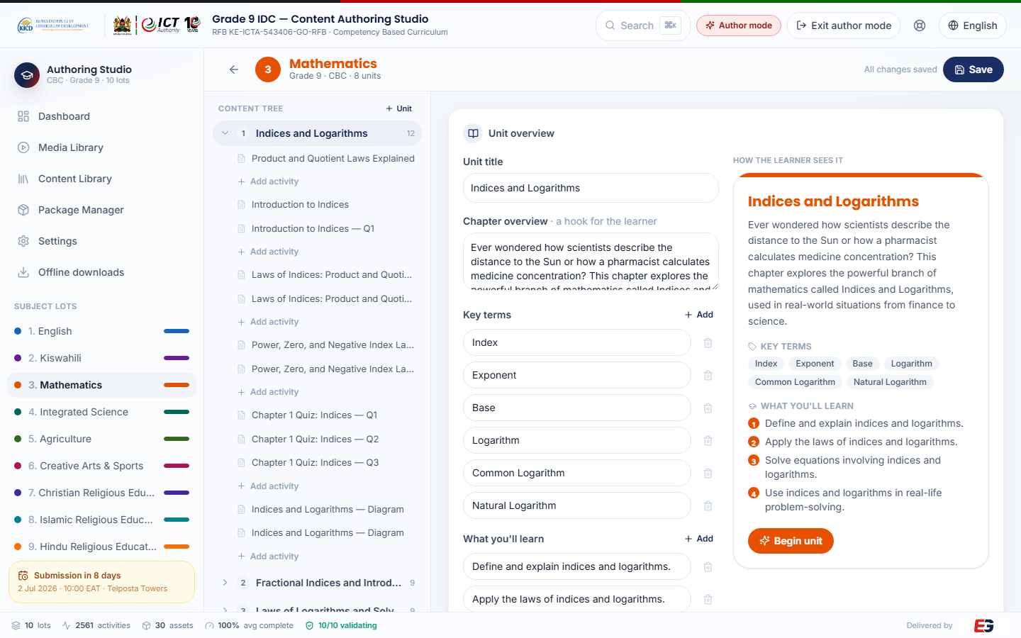
The Lot Editor
One screen per subject: a content tree on the left, the editor in the middle, the learner's view on the right.
1
Content tree — units contain lessons (topics), which contain activities. Click to select.
5
2
2
+ Unit adds a unit; Add activity (under any lesson) opens the activity-type picker.
1
3
4
3
Unit overview — edit the title, hook, key terms and learning outcomes.
4
How the learner sees it — a live preview of the unit intro.
5
Save stores the project in this browser; export to JSON for a durable backup.
Evergain Limited · Grade 9 Interactive Digital Content · Administrator & Author Guide
Notes:
Selecting an activity in the tree replaces the unit overview with that activity's editor plus Preview, Move up/down and Delete.

Slide 6
Activity types you can author
Every activity also carries a title, a CBC core competency tag (required), a difficulty (1–3) and estimated minutes.
Type | What the learner gets | What you fill in
Multiple choice | One question, four options, instant feedback | Question, options (exactly one correct), feedback, hint
True / False | A statement to judge | Statement, answer, feedback
Fill in the blank | Type the missing term | Prompt with [[answer]] markers, hint, case-sensitivity
Matching pairs | Match terms to meanings | Pairs (left ↔ right)
Reading | Passage with a check question and Listen | Body text, check question and answer
Video lesson | Streams online (YouTube id), bundled MP4 offline | Video id, title, source, transcript, key points
Audio / Podcast | Listen-along narration | Transcript, key points (podcast embed optional)
Virtual lab | PhET simulation, bundled offline | PhET sim URL, instructions, background
Learning game | Sort / sequence / memory / anagram, auto-scored | Game kind and its items or pairs
Animation | Staged process diagram with narration | Stages in order, caption, explanation
Image study | A PNG/JPEG diagram with explanation | Image (PNG/JPEG only), caption, explanation
Evergain Limited · Grade 9 Interactive Digital Content · Administrator & Author Guide
Notes:
Delivered packages accept MP4, MP3, JPEG and PNG media only, and no external links — the validator enforces this before packaging.

Slide 7
Add or edit an activity
The everyday authoring loop.
1
Open the subject and expand a unit
Dashboard → Edit on the subject card (or click the subject in the sidebar), then click a unit in the content tree.
2
Click Add activity under the lesson, and pick a type
The picker lists the activity types. To change an existing activity, just click it in the tree.
3
Fill in the fields and tag a competency
Every activity must carry one CBC core competency. Keep questions to exactly one correct option; use Kenyan contexts.
4
Preview, then Save
Preview shows the exact HTML the learner package will use. Save keeps the work in this browser; Move up/down reorders; Delete removes.
5
Export a backup
Settings → Export project (JSON) after each session. Import restores it on any computer; Reload official content resets everything.
Evergain Limited · Grade 9 Interactive Digital Content · Administrator & Author Guide
Notes:
Content lives in the browser until it is exported and rebuilt into the platform — see the Build & publish slide.

Slide 8
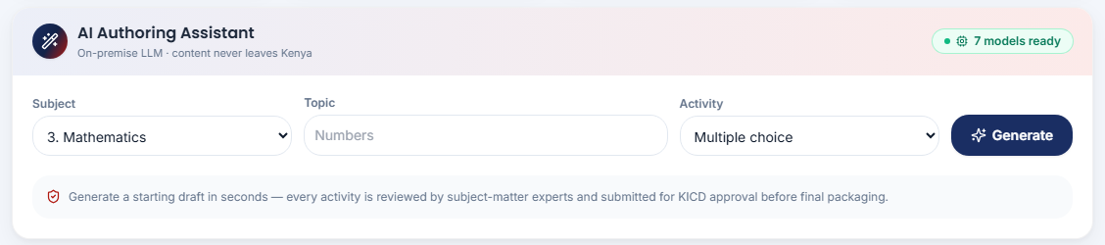
AI Authoring Assistant
Drafts a starting activity in seconds from a subject, topic and type — on an on-premise model, so content never leaves Kenya.
5
1
2
3
4
1
Subject
2
Topic
3
Activity type
4
Generate
5
Status
Pick the lot the draft is for.
A few words, e.g. "linear equations".
Multiple choice, True/False or Fill in the blank.
A draft appears with options, feedback and a competency.
"7 models ready" = available; "AI offline" = drafting disabled, everything else works.
Review every draft before saving: Add to <subject> inserts it into the first lesson of that lot; Copy JSON lets you paste it elsewhere. AI is used at authoring time only — the delivered learner packages contain no AI.
Evergain Limited · Grade 9 Interactive Digital Content · Administrator & Author Guide
Notes:
The on-premise LLM runs on the Vilcom network. When it is unreachable the badge reads "AI offline" — authoring by hand is unaffected.

Slide 9
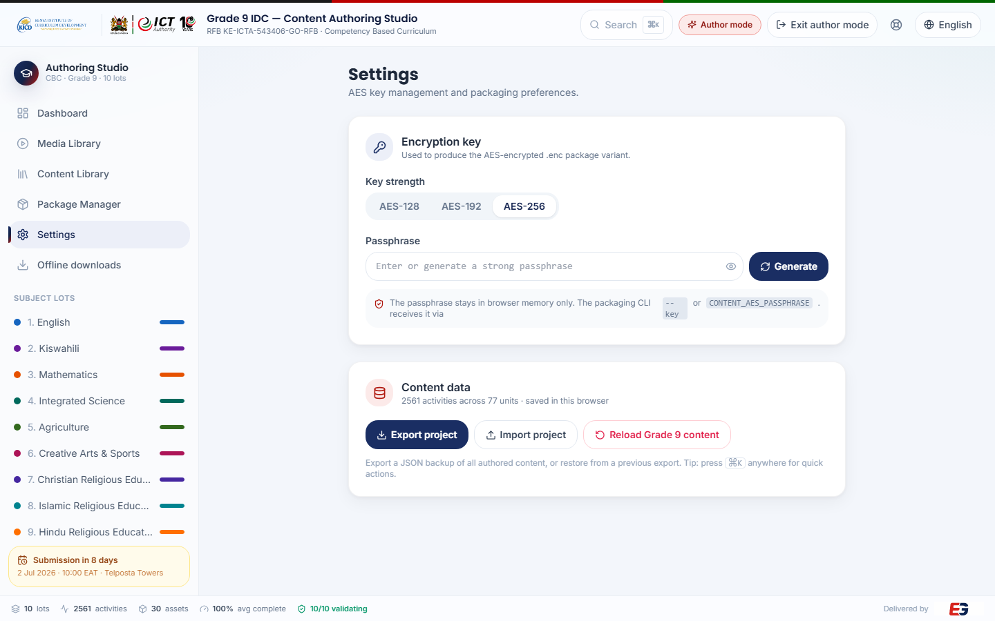
Settings: export, import, reset
Author mode only. Your safety net for the content stored in this browser.
1
Export project (JSON) — a complete, dated backup of all ten lots. Do this after every editing session.
2
Import project (JSON) — restore a backup, or move work between computers.
3
Reload official Grade 9 content — discards local edits and reloads the shipped content (asks first).
4
The same actions are in the command palette: Ctrl/Cmd + K.
Evergain Limited · Grade 9 Interactive Digital Content · Administrator & Author Guide
Notes:
Because content is kept per browser, treat Export as "save to file". The published platform is rebuilt from the exported JSON.

Slide 10
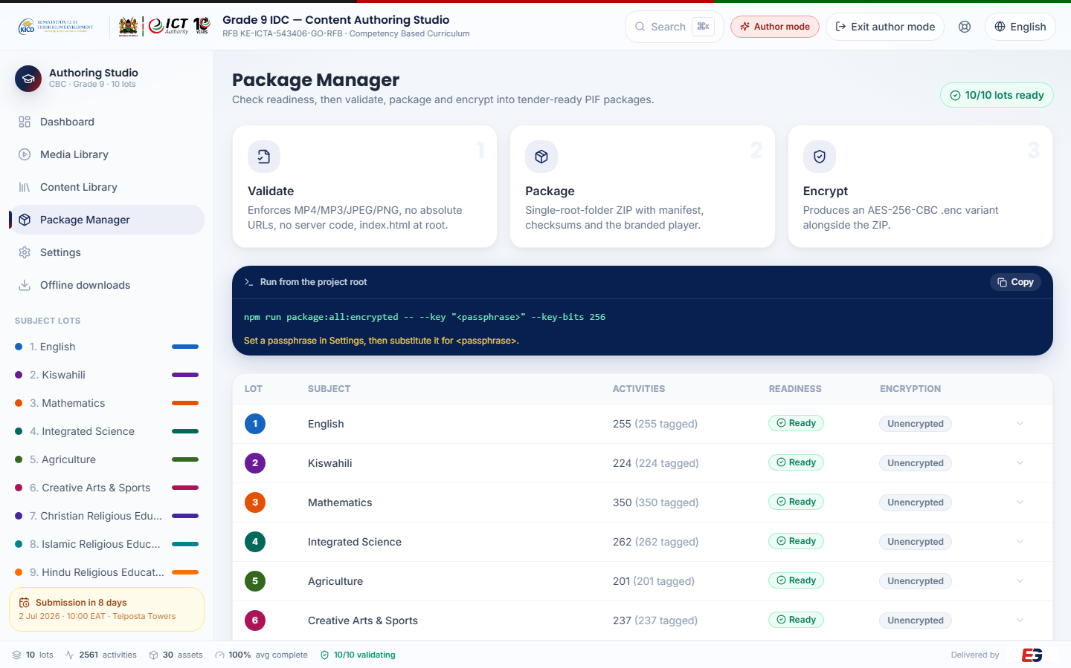
Package Manager: validate → package → encrypt
Produces the tender-format PIF packages for each lot, ready for physical media.
1
Readiness per lot — activities, competency tags, and whether the lot is ready.
2
Validate — rejects disallowed media (anything but MP4/MP3/JPEG/PNG), server-side code and external links.
3
Package — one self-contained ZIP per lot with index.html at the root, a manifest and checksums.
4
Encrypt — an AES-256 .enc variant of each package; keep the passphrase on the key-custody sheet.
Evergain Limited · Grade 9 Interactive Digital Content · Administrator & Author Guide
Notes:
The learner flash-disk packages on the download page are built by a separate script (next slide); the PIF packages are the formal tender deliverable.

Slide 11
Build & publish (technical)
Run from the project folder cbc-kicd-grade9 on the build machine. Env vars are set in the shell (Git Bash shown).
Task | Command | Output
Online platform (learner default + author gate) | npm run build:authoring | dist/authoring → webroot /var/www/cbc.evergain.co.ke
All-subjects learner flash-disk app | VITE_OFFLINE=1 VITE_LEARNER=1 npm run build:authoring OFFLINE_OUT=dist/offline-learner node tools/finalize-offline-spa.mjs | dist/offline-learner (single index.html + media + sims)
Ten per-subject learner packages | npx tsx tools/build-learner-packages.ts (LOT=3 for one) | dist/learner/Evergain_Grade9_LOT-NN_<Subject>/ + .zip
Publish downloads | Copy the .zip files to /var/www/cbc.evergain.co.ke/downloads/ (chmod a+r) | cbc.evergain.co.ke/download/…
Short links (nginx) | location = /download/<slug> { return 302 /download/<file>.zip; } | cbc.evergain.co.ke/download/mathematics etc.
Change the author passcode | Edit AUTHOR_CODE in src/authoring/stores/uiStore.ts, then rebuild + redeploy | New passcode takes effect for new sign-ins
Evergain Limited · Grade 9 Interactive Digital Content · Administrator & Author Guide
Notes:
Deploy is tar → scp → extract over the webroot; keep the downloads/ folder intact. The packages read media from cbc-kicd-grade9/media/video (one MP4 + .vtt per lesson).

Slide 12
Download links to share
Each link redirects to the current file, so the links stay valid when packages are rebuilt.
Lot | Learning area / item | Link
1 | English | cbc.evergain.co.ke/download/english
2 | Kiswahili | cbc.evergain.co.ke/download/kiswahili
3 | Mathematics | cbc.evergain.co.ke/download/mathematics
4 | Integrated Science | cbc.evergain.co.ke/download/integrated-science
5 | Agriculture | cbc.evergain.co.ke/download/agriculture
6 | Creative Arts & Sports | cbc.evergain.co.ke/download/creative-arts-sports
7 | Christian Religious Education | cbc.evergain.co.ke/download/christian-re
8 | Islamic Religious Education | cbc.evergain.co.ke/download/islamic-re
9 | Hindu Religious Education | cbc.evergain.co.ke/download/hindu-re
10 | Social Studies & Pre-Technical Studies | cbc.evergain.co.ke/download/social-studies-pts
All | All ten subjects — learner app (156 MB) | cbc.evergain.co.ke/download/all
— | Learner Guide (this deck's companion) | cbc.evergain.co.ke/download/learner-guide
— | Administrator & Author Guide | cbc.evergain.co.ke/download/admin-guide
— | Technical Proposal · Platform Overview (Word) | cbc.evergain.co.ke/download/proposal · /download/overview
Evergain Limited · Grade 9 Interactive Digital Content · Administrator & Author Guide
Notes:
The download page itself is cbc.evergain.co.ke/download/ — also reachable from Offline downloads in the app sidebar.

Slide 13



Security and good practice
The gate keeps learners out of editing; these habits keep the content safe.
The passcode
Protect the content
Shared computers
It is a mode gate, not a security boundary — the app runs in the browser.
Share it only with curriculum developers; never with learners.
Rotate it by editing AUTHOR_CODE and rebuilding.
Author mode is remembered per browser until Exit author mode.
Export a JSON backup after every session; keep dated copies.
Ship learners the flash-disk editions — authoring is compiled out of them.
Rebuild and redeploy after content changes so the site and packages match.
Keep the AES passphrase for encrypted PIFs on the key-custody sheet only.
Click Exit author mode before leaving a computer.
Reload official content clears local edits — confirm before using it.
Learners on the same PC see whatever mode the browser is left in.
Use a private window for one-off edits if in doubt.
Evergain Limited · Grade 9 Interactive Digital Content · Administrator & Author Guide
Notes:
The learner packages and flash-disk editions cannot be switched into Author mode at all.

Slide 14



Troubleshooting
Symptoms you may see, and what they mean.
Content looks old
"AI offline" badge
Media or packaging
The browser cached an earlier project: press Ctrl+F5, or Settings → Reload official content.
After a redeploy, bump the store version in contentStore.ts so every browser refreshes.
The on-premise model host is unreachable from this deployment.
Drafting is disabled; all authoring, previewing and packaging still work.
A video shows blank online: the activity has no YouTube id — add one (offline it plays the bundled MP4).
Validation fails: a disallowed file type or an external link — fix the activity and re-validate.
A .zip will not download: the file must be in the downloads folder and world-readable.
Evergain Limited · Grade 9 Interactive Digital Content · Administrator & Author Guide
Notes:
For anything else, contact Evergain support (last slide) with the subject, unit and activity title.

Slide 15
Support
Online platform: cbc.evergain.co.ke (Author sign-in at the top right)
Downloads & guides: cbc.evergain.co.ke/download/
Evergain Limited · info@evergainlimited.com · +254 747 258 516 · www.evergainlimited.com
Grade 9 Interactive Digital Content for the Competency Based Curriculum — delivered for ICTA / KICD (RFB KE-ICTA-543406-GO-RFB).
Evergain Limited · Grade 9 Interactive Digital Content · Administrator & Author Guide
Notes:
Thank you.

